Slide 1
The Hypothetical Intent Test
Richard Warner

Slide 2
Objective intent test adequately resolves any ambiguity?
Yes
No
Use objective intent test
Misunderstanding?
Yes
No
One party knows or should know of the misunderstanding?
Main purpose of the contract can be determined?
No
Yes
Yes
No
No contract under Restatement 201—note this may not be the result you want
Interpret against party with knowledge, etc.
Use hypothetical intent test
Use other strategies

Slide 3
Spaulding v. Morse
There is a divorce decree followed by agreement in which father (George) promises to pay $1200 a year to his son Richard "until Richard D. Morse enters some college".
Richard is drafted into the army the day after he graduates from high school (it is 1946).
Does George have to pay $1200 a year?

Slide 4
The Objective Intent Test
What would a reasonable outsider think was promised by "until Richard D. Morse enters some college"?
    Including the army
    Not including the army
That George should pay until college?
  If so, George should pay while Richard is in the army?
The court does not use the objective intent approach.
Why?

Slide 5
The Objective Intent Test Result
This:
  “George shall pay to Ruth $100 per month until Richard enters college, and, thereupon, and for a period not to exceed four years thereafter, to pay $ 2,200 a month to Ruth.”
is ambiguous.
It could plausibly be interpreted in two inconsistent ways:
  George pays while Richard is in the army.
  George does not pay while Richard is in the army.

Slide 6


Why That Result?
Ask, What Did Ruth and George think about the possibility that Richard would be drafted into the army?
Nothing in the circumstances suggests to a reasonable person any particular interpretation of the words and actions in regard to Richard being drafted.

Slide 7


Compare Embry v. McKittrick
No ambiguity, no misunderstanding
Promise
“Go ahead . . .”
I am not promising
He is promising
The reasonable person.
McKittrick
Embry

Slide 8
No Ambiguity Because . . .
There is no ambiguity because the reasonable person assigns the words one meaning: namely, a promise of employment.
Promise
“Go ahead . . .”
No promise
Promise
The reasonable person.
McKittrick
Embry

Slide 9
No Misunderstanding Because . . .
There is no misunderstanding because the reasonable person sees the promisor and promise as understanding the words in the same way: namely, as a promise of employment.
Promise
“Go ahead . . .”
No promise
Promise
The reasonable person.
McKittrick
Embry

Slide 10
Compare: Ambiguity and Misunderstanding
Raffles v. Wichelhaus
Could be early
Could be late
“Peerless”
Early Peerless
Late Peerless
The reasonable person.

Slide 11
Objective intent test adequately resolves any ambiguity?
Yes
No
Use objective intent test
Misunderstanding?
Yes
No
One party knows or should know of the misunderstanding?
Main purpose of the contract can be determined?
No
Yes
Yes
No
No contract under Restatement 201—note this may not be the result you want
Interpret against party with knowledge, etc.
Use hypothetical intent test
Use other strategies

Slide 12
Ambiguity, No Misunderstanding
Spaulding v. Morse
Could pay in the army
Could be not pay in the army
The reasonable person.

Slide 13
The Question
How do you interpret contractual language when the objective intent test only yields “Ambiguous” and you have no misunderstanding?
Spaulding uses the hypothetical intent test.

Slide 14
Hypothetical Intent
Do you have ambiguity without misunderstanding?
Yes
No
Determine the main purpose of the contract
Do not use the hypothetical intent test
Given that purpose, would reasonable parties agree that P is obligated to do X?
Yes
No
P is obligated to do X
P is not obligated to do X

Slide 15
Commentary
The court not really reconstructing what would have happened George and Ruth had raised the issue of the army. How could court know that?
It is really asking what would be reasonable given what appears to be overall aim.
It substitutes it's judgment for the parties’.

Slide 16
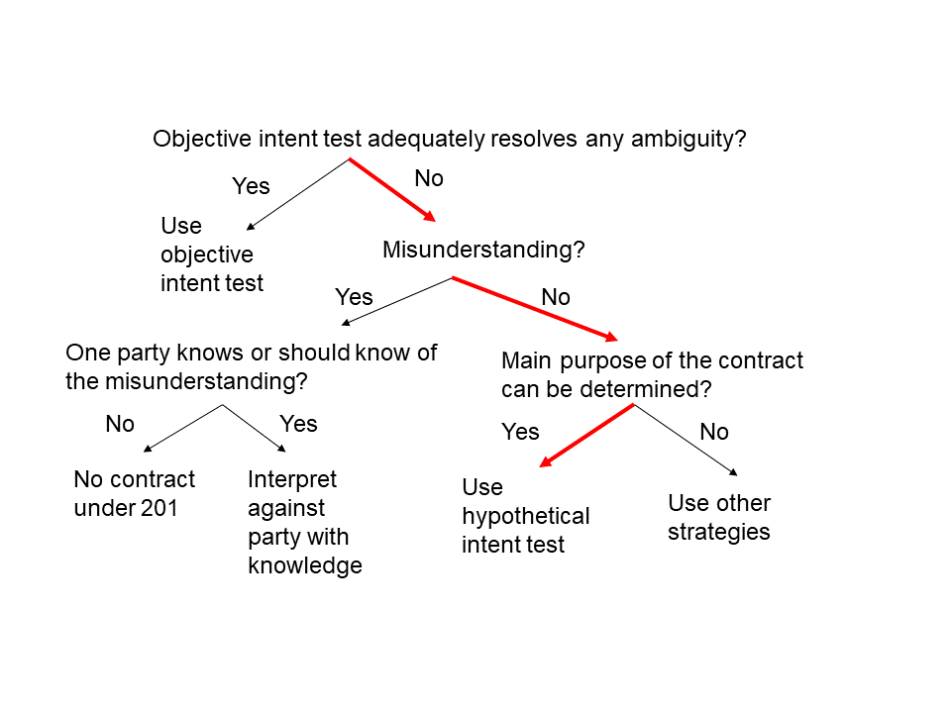
Need both:
Ambiguity and no
Misunderstanding

Slide 17
Compare Frigalament
Frigaliment, a Swiss company, orders “chickens” from B.N.S, a US company. The contract does not specify whether the chickens are to be young, tender, expensive fryers, or old, tough, cheap boilers. Frigaliment intends to order fryers, but the price quoted is the price for boilers. Neither side discusses the issue. Frigaliment is new to the chicken business. There is no relevant trade usage as to the term, “Chicken.” Chickens R Us ships boilers; Frigaliment refuses to accept delivery. Who breached?
Issue: When Chickens R Us said they would ship “chickens” did they promise to send fryers?
Rule: The words “ . . .chicken. . “ are a promise to send fryers if a reasonable person would so interpret them.
Analysis: Would a reasonable person interpret the words “ . . .chicken. . “ as a promise to send fryers?

Slide 18
Frigaliment v. B.N.S. International Sales
190 F. Supp. 116 (S.D.N.Y. 1960)
Judge Friendly’ decision:
“When all the evidence is reviewed, it is clear that defendant believed it could comply with the contracts by delivering stewing chicken in the 2½-3 lbs. size. Defendant's subjective intent would not be significant if this did not coincide with an objective meaning of "chicken." Here it did coincide with one of the dictionary meanings, with the definition in the Department of Agriculture Regulations to which the contract made at least oblique reference, with at least some usage in the trade, with the realities of the market, and with what plaintiff's spokesman had said. Plaintiff asserts it to be equally plain that plaintiff's own subjective intent was to obtain broilers and fryers; the only evidence against this is the material as to market prices and this may not have been sufficiently brought home. In any event it is unnecessary to determine that issue. For plaintiff has the burden of showing that "chicken" was used in the narrower rather than in the broader sense, and this it has not sustained.”

Slide 19
No Ambiguity, No Misunderstanding
Boilers
Fryers
Boilers
The reasonable person.
Chickens R Us
Ace

Slide 20
Judge Friendly Never Reaches the Hypothetical Intent Test
Objective intent test adequately resolves any ambiguity?
Yes
No
Use objective intent test
Misunderstanding?
Yes
No
One party knows or should know of the misunderstanding?
Main purpose of the contract can be determined?
No
Yes
Yes
No
No contract under 201
Interpret against party with knowledge
Use hypothetical intent test
Use other strategies

Slide 21
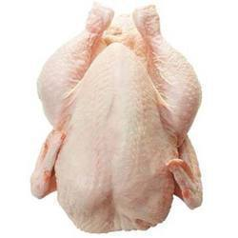
Frozen, Eviscerated Chickens
Ace Trucking promises Chickens R Us to transport frozen, eviscerated chickens from Chickens R Us’ plant in Georgia to a warehouse in North Carolina. Chickens R Us promises to pay. The agreement contains the following clause (among others). Chickens R Us promises to reimburse Ace for any charges it incurs for transporting manufactured products across state lines. Neither Ace nor Chickens considers whether a frozen, eviscerated chicken is manufactured product. The Interstate Commerce Commission holds that it is and imposes charges on Ace Trucking. Ace pays the charges. Chickens refuses to pay.

Slide 22
Hypothetical Intent?
Neither Ace nor Chickens considers whether a frozen, eviscerated chicken is manufactured product.
Could be fryers
Could be boilers
But is there a relevant main purpose to the contract?
The reasonable person.
Chickens R Us
Ace

Slide 23
Sowle and McCartney
Steve Sowle owns and operates Sole Saver, Your Sowle Stop for Shoe Repair. Paul McCartney owns and operates Rubber Sole, a supplier of natural rubber soles to shoe repair shops (natural rubber is rubber obtained from rubber trees). Sowle and McCartney enter into a contract in which Sowle will purchase 500 natural rubber soles for $5 a sole (the contract does not impose any specifications on the soles beyond their being made of natural rubber). On October 1, a virus unexpectedly attacked all of the world’s rubber trees and the result is that natural rubber soles are far more flexible than the used to be and cannot be used to repair shoes. Sowle claims that he is not obligated to purchase the more flexible soles.
Under the hypothetical intent test, there is a plausible argument that Sowle is correct.
(a) True
(b) False

Slide 24
Crique du Sowlé
Steve Sowle owns and operates Crique du Sowlé, the sole Sowle soul circus. Sowle is negotiating with Ruddy Stein of the circus supply company, Equipment Roche, for aerial silks. They meet to sign a written contract for “40 red aerial silks.” Just before he signs, Sowle says, “You know I have changed my mind. I need blue silks. Can we agree that in this agreement ‘red’ means blue?” Stein says, “Agreed.”
(a) Sowle promised to buy red silks.
(b) Sowle promised to by blue silks.

